Slide 1
Lesson 3: Creating the left column
Notes:
Template version: 11/20/2012, for PowerPoint 2007 & 2010

Slide 2
HTML
First, lets make our header bigger
Surround the Column 1 text in <h1> tags like below
Your website will now look like this

Slide 3
HTML
Lets add an image that will be the icon that you click
To add an image, replace “./circle.png” with your own image, in the same folder

Slide 4
HTML continued
Your website should now look like this:

Slide 5
HTML continued
The circle is way too big
In order to do this, we need to add a class tag to the circle like below
We can set a size for the circle with css
In the style.css file add the section below at the bottom
And now your circle is smaller

Slide 6
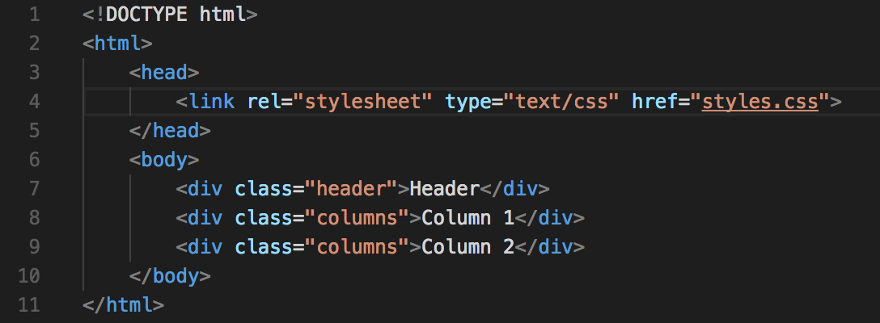
HTML continued
Now back in the index.html file, we need to add those classes in order to change the elements

Slide 7
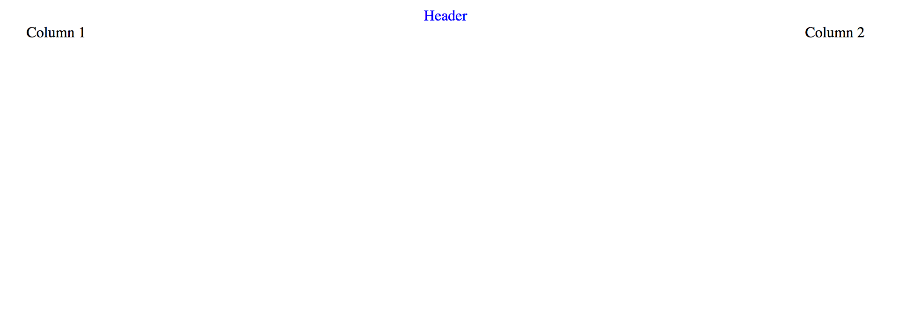
HTML continued
The website should now look like:

